Slide 1
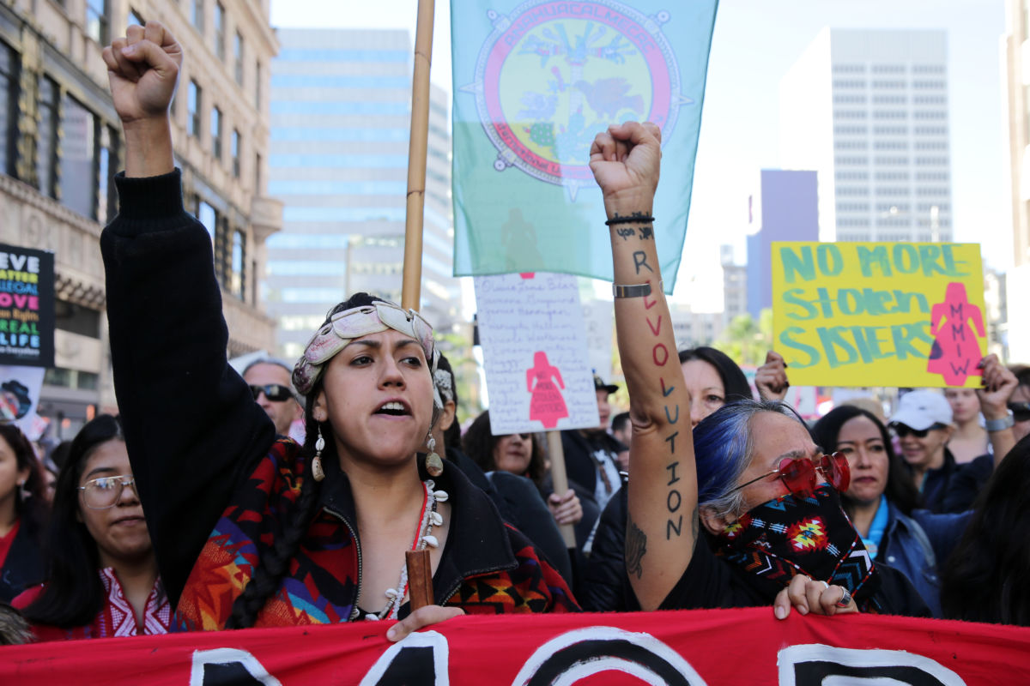
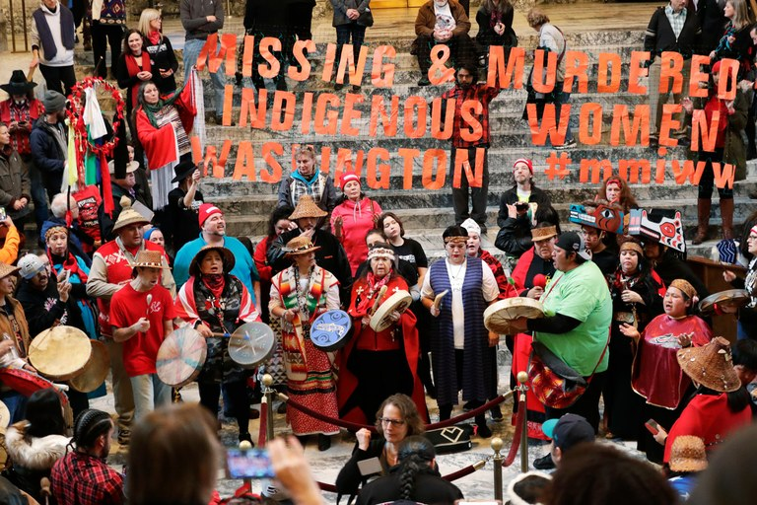
Canada’s Missing and Murdered Indigenous Women and Girls

Slide 2
https://www.youtube.com/watch?v=6DLZgG15c-o

Slide 3
What is the connection between the child welfare system and the epidemic of missing and murdered indigenous women?
The child welfare system devalues indigenous life, especially for indigenous women and girls
When the children in the system turn 18, they are on their own
Unequipped with life skills
Severed from their families and home communities
This leads to homelessness, substance abuse, sexual exploitation

Slide 4
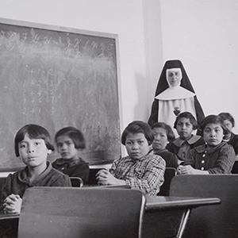
Why are so many indigenous
children in the child welfare system?
Simply put, Residential Schools. Here’s why...
Many of the indigenous children placed into the child welfare system are the children of Residential School survivors
Residential schools separated indigenous children from their families
The aim was to “kill the Indian in the child”
At these schools, children suffered emotional, physical, and sexual abuse

Slide 5
But, why do so many of their children find themselves in
Canada’s child welfare system, separated from their parents?
Abuse and trauma hindered victims’ ability to take care of their own children
In being separated from their own families and communities, they did not learn from their own parents how to be caring and nurturing parents themselves - what they learned was abuse
Many Indian residential school survivors, themselves, have made this point
Josie Bear, a First Nations elder, was exposed to severe discipline as a student in residential schools. As she states, because of this, she treated her own children much the same
"I brought them up in a pretty horrible way - didn't know how to parent, didn't know how to show love"
Abuse and trauma also hindered victims’ ability to succeed in life
Homelessness or poverty, substance abuse
This then led to the “poverty” and “lack of adequate food or housing” that the government cites as reasons for putting indigenous children into the child welfare system

Slide 6
So, to sum it up, the Canadian government forced the past indigenous population into residential schools.
This led to trauma, which then led to an inability to care for the next generation.
This resulted in much of the next generation being placed in Canada’s child welfare system.
This led and still leads to homelessness, substance abuse, and sexual exploitation amongst many contemporary indigenous youth - of which women and girls are especially vulnerable to.

Slide 7
Police response to missing/murdered indigenous women and girls has been insufficient. What steps are indigenous activists taking?
Only some of many examples:
Drag the Red
Indigenous activists search the Red River in Manitoba themselves, looking for human remains of missing and murdered indigenous women
Claudette Osborne
Her family led her own investigation themselves - put up posters, talked to witnesses, followed up on her whereabouts
Midnight Medicine Walk
The purpose of which is 1) to reach out to women that are being sexually exploited, to offer them prayers and medicine, and to let them know they are being watched after and 2) to send a message to the men that pray on them that they are being watched by the community
Bear Clan Patrol
Community safety patrol that operates in dangerous neighborhoods

Slide 8
Canada’s National Inquiry into Missing and
Murdered Indigenous Women and Girls
Stephen Harper and his conservative government did not recognize this as an issue
Justin Trudeau and his liberal government initiated the national inquiry
Its job?
Examine the systemic causes of violence against indigenous women
Offer recommendations on how to keep them safe
But, what indigenous activists wanted was an action-plan
They wanted resources and preventions put in place to stop violence from happening now
They worry there will be no legal outcome as a result of the national inquiry

Slide 9
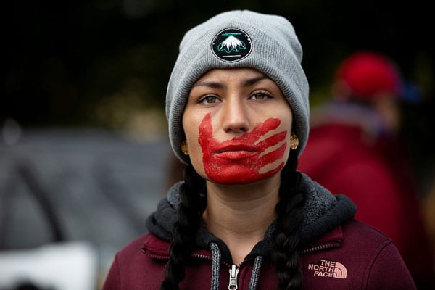
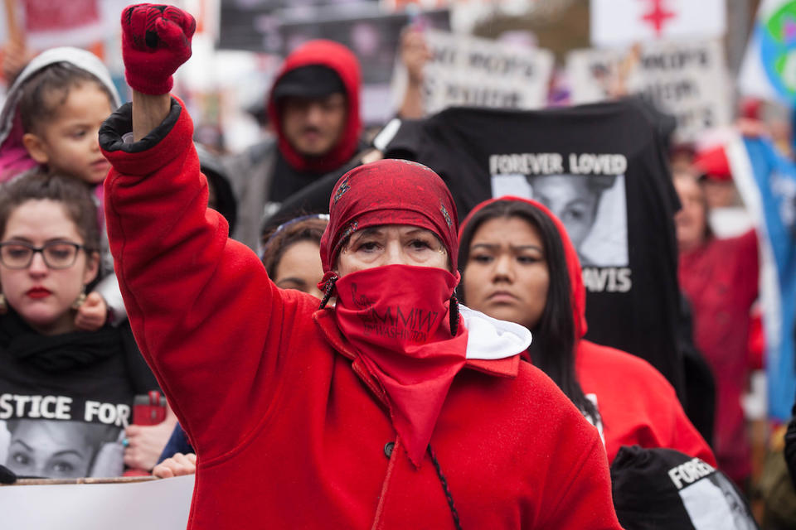
Inquiry into Murdered and Missing Indigenous Women and Girls
Final Report 2019
Notes:
“Red is the only colour spirits can see. So, in wearing red, we call the spirits of these women back to us, allowing them a chance to be among us and have their voices heard through their family members and community.'"

Slide 10
After the 2015 Canadian federal election, the Liberal Government upheld their campaign promise and announced the initiation of a Canadian National Inquiry into Missing and Murdered Indigenous Women and Girls.
The final report was released in June, 2019.

Slide 11
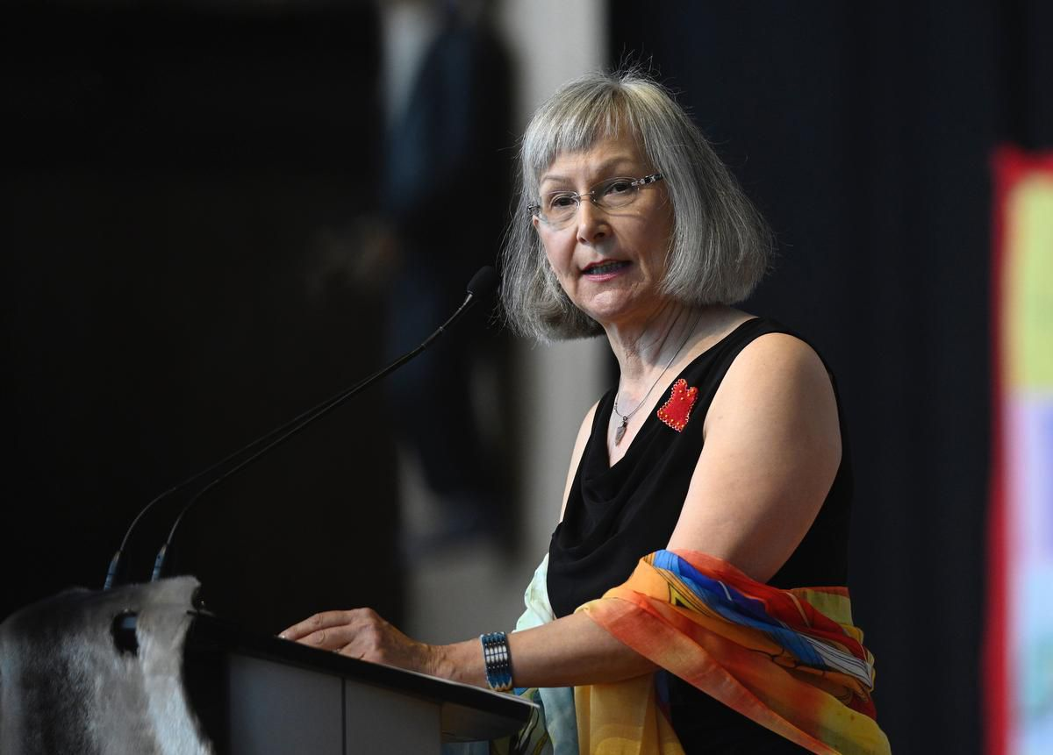
Marion Buller, chief commissioner of the inquiry, said that the report’s calls for justice are not just "recommendations" but are "legal imperatives" that must be implemented to help end a cycle of violence that has claimed the lives of thousands of Indigenous women.
"This report is about Indigenous people and the systemic factors that lead to their losses of dignity, humanity and, in too many cases, losses of life.
“This report is about deliberate race, identity and gender-based genocide.”

Slide 12
The inquiry found that...
Indigenous women and girls are 12 times more likely to be murdered or to go missing than members of any other demographic group in Canada — and 16 times more likely to be slain or to disappear than white women.
Too often, Indigenous murder investigations are marked by indifference and negative stereotypes; causing Indigenous deaths and disappearances to be investigated and treated with less care and determination.
When there is a reasonable chance of a conviction, Crown attorneys are too often willing to accept plea bargains or reduced charges in exchange for guilty pleas.

Slide 13
Calls for justice...
More Indigenous judges, justices of the peace and police should be hired to ensure Indigenous voices are in positions of power in the criminal justice system.
The RCMP need fundamental reforms. Ottawa should establish "robust and well-funded Indigenous civilian police oversight bodies" to prevent police negligence and misconduct in murder, rape, and sexual assault cases.
The government should offer guaranteed access to financial support, legislated paid leave and disability benefits and "appropriate trauma care" to Indigenous victims of crime or other traumatic events.

Slide 14
"Skeptics will be fearful and will complain that the financial cost of rebuilding is too great, that enough has been done, that enough money has been spent," said Buller. "To them I say, we as a nation cannot afford not to rebuild. Otherwise, we all knowingly enable the continuation of genocide in our own country."
- Marion Buller

Slide 15
What now?
"To the survivors and families here today, and to those watching or listening at home, I want you to know that this report is not the end. The work of the commissioners, the stories they have collected, and the calls for justice they have put forward will not be placed on a shelf to collect dust.
You have my word that my government will turn the inquiry's calls for justice into real, meaningful, Indigenous-led action …”
- Justin Trudeau
No, really, what now?

